Slide 1

Analysis of used bikes on bikekharido.in

Slide 2
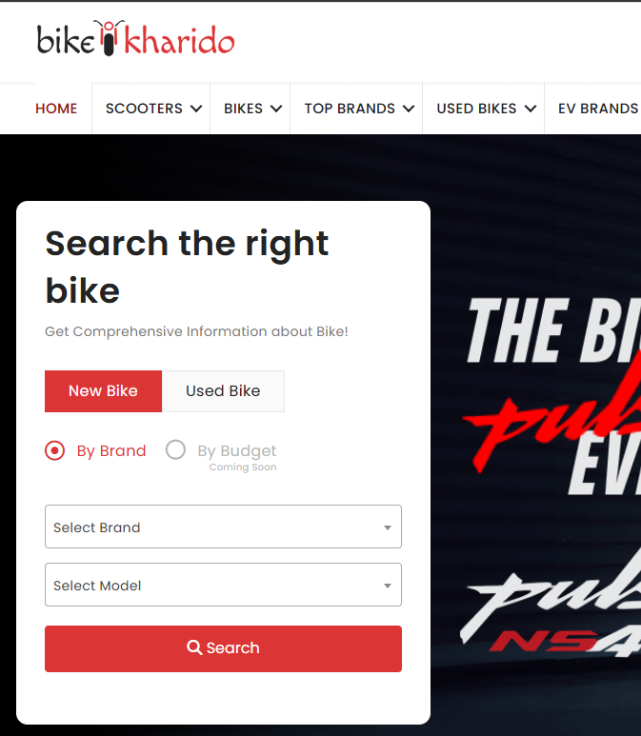

Intro
Bike Kharido is based on selling and buying two wheeler vehicles.
For used bikes we get list of bikes of all manufacturers over 50 pages
But there is no price range and proper order available for bikes based on popularity and mostly available for sale.
We are analyzing the data to identify which manufacturer bikes are mostly available for sale, so to have them in initial pages.
Also, providing an application to quickly get the bikes on price range and other parameters
Analysis of used bikes on bikekharido.in
section

Slide 3
Tasks
Data extraction/ Web Scraping
Preprocessing
Data analysis
Visualization
Streamlit application

Slide 4
Tasks
Data extraction/ Web Scraping
Preprocessing
Data analysis
Visualization
Streamlit application
identify the columns
identifying the special characters
Univariate
univariate
getting data from CSV file
Identification of layers
identifying empty values
Bi variate
Bi variate
Creating input fields to apply filter
collecting data from multiple layers
analyzing the columns
Multi variate
Multi variate
handling defaults
Combining the data
changing data types
Identifying outliers
getting insights from the graphs
visualization
Data cleaning
removing the redundant columns
Missing data
conclusion and summary
deployment in streamlit cloud

Slide 5
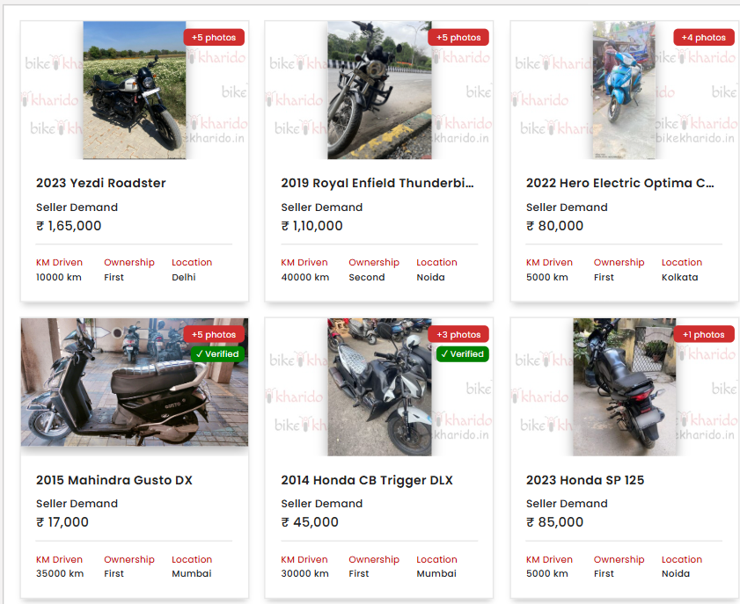
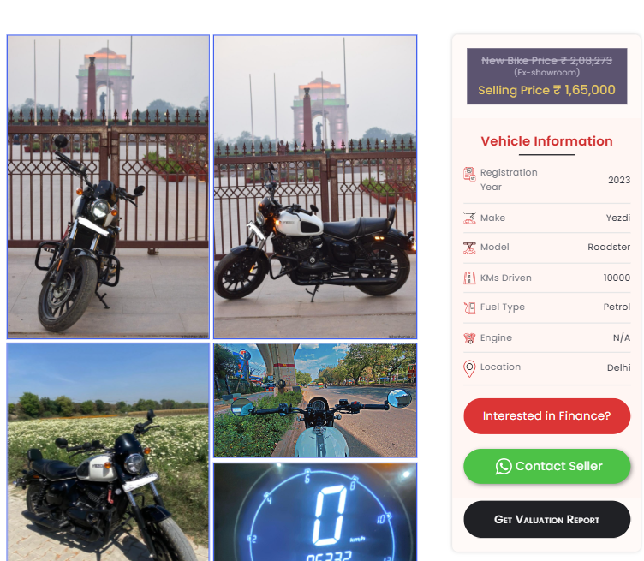
Data extraction / Web Scraping
Two-Layer Page Structure: List of bikes (Layer 1) and detailed info (Layer 2).
Data Import: Store bike listings with URLs in a dataframe.
Data Fetching: Use URLs to fetch detailed information for each bike.
Data Integration: Separate details into lists based on positions.
Data Cleaning: Remove redundant columns and format data using Regex.

Slide 6
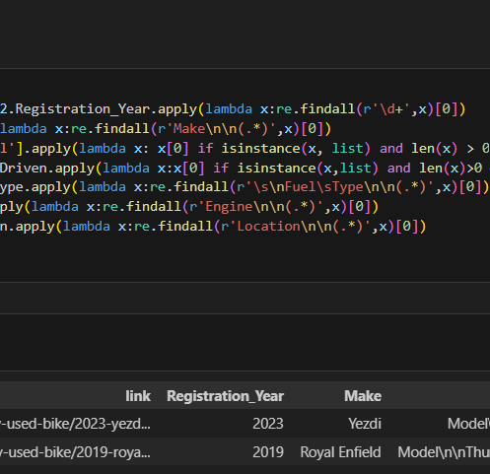
Preprocessing
Price Column Pattern Adjustment: Fixed records missing the rupee symbol.
Price Column Cleaning: Removed commas and assigned integer datatype.
Handled Missing Features: Managed cases where some bike features were unavailable.
Numerical Columns Cleaning: Cleaned and assigned appropriate datatypes for numerical columns.
Data Merging: Merged data from two layers and removed redundant columns.

Slide 7
Data Analysis
Features:
Name: Consisting name of the bike with complete info
Price: Price of bike in rupees ( 10,000 to 8,50,000 )
Ownership: Ownership of bike being sold ( First, Second, Third, Above )
link : Contains link of each bike
Registration_Year: This contains the registration year of the bike
Make: Manufacturer name
Model: Contains model name of the bike
KMs_Driven: Shows the no of kilometers driven by the bike
Fuel_Type: Fuel type of bike ( Petrol, EV )
Engine: Engine capacity
Location: Location of bike being sold from

Slide 8
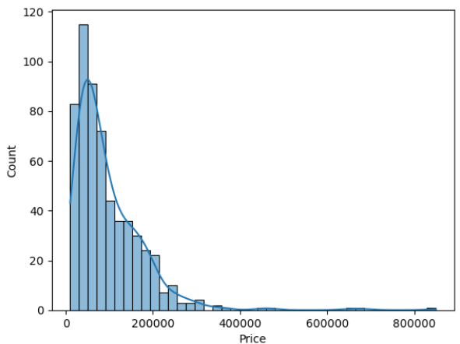
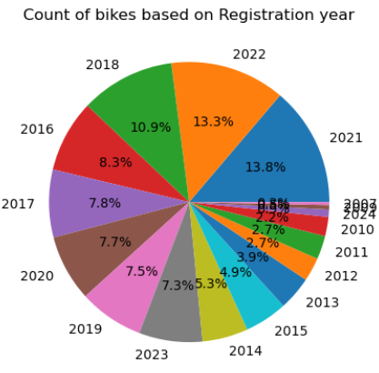
Data Analysis
Univariate Analysis
Price:
Minimum: 10000 and Maximum: 850000
Average : 97368.76
Most of the bike prices lie in range from 50K to 100K
Registration year:
registration year: from 2007, 2024( 2008 missing)
most of the bike having registration year as 2021

Slide 9
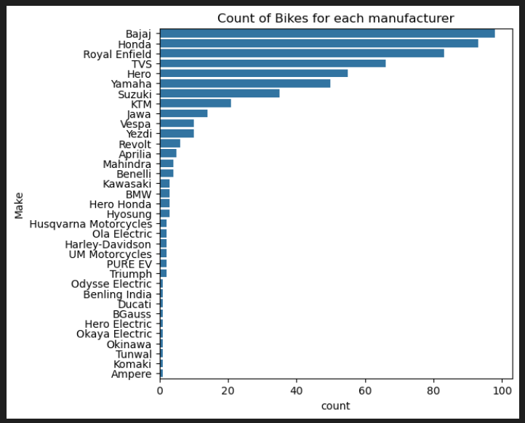
Data Analysis
Univariate Analysis
Make:
Top : 5 Manufacturers:
Bajaj 98,Honda 93,Royal Enfield 83, TVS 66,Hero 55
Last : 5 Manufacturers:
Ampere
BGauss
Tunwal
Benling India
Ducati

Slide 10
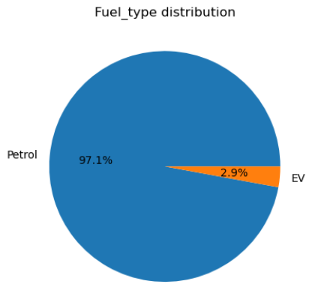
Data Analysis
Univariate Analysis
Model:
Top : 5 Models:
NTORQ 125 15,Classic 350 15,Bullet 350 14,Interceptor 650 11, Pulsar 150 11
Fuel_Type:
Petrol: 97.1%
EV : 2.9%

Slide 11
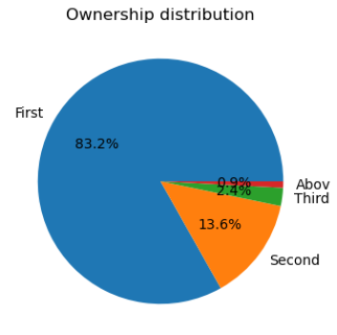
Data Analysis
Univariate Analysis
Ownership:
First: 489
Second: 80
Third: 14
Above: 5
Engine:
Highest: 1215 cc ( triumph 1200 GT )
Lowest: 87.80 cc ( Scooty Pep Plus )

Slide 12
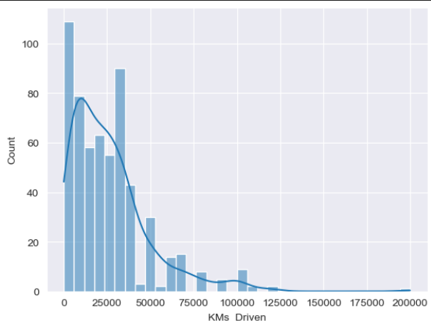
Data Analysis
Univariate Analysis
Kilometers_Driven:
Max: 200000 (Suzuki Access 125)
Min: Revolt rv 400 (2022) 273
( for unicorn 160, KMs driven is missing)

Slide 13
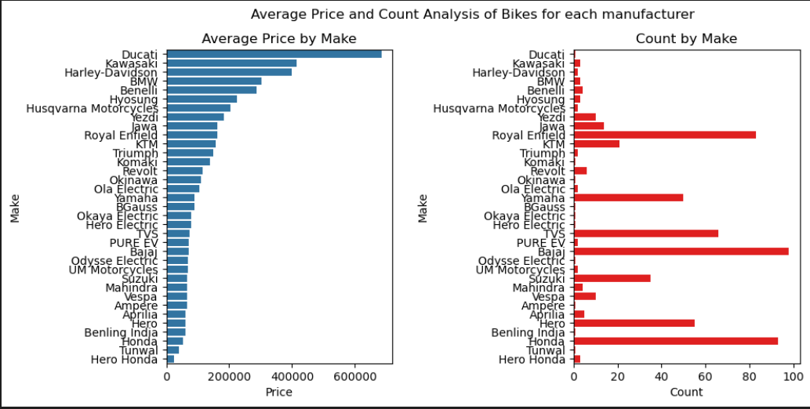
Data Analysis
Bi variate Analysis
Price vs Make: Average price is higher for Ducati, Kawasaki, BMW, Benelli.
Make vs Count of Bikes: Most bikes are from Bajaj.
Royal Enfield: Higher count despite above-average price.

Slide 14
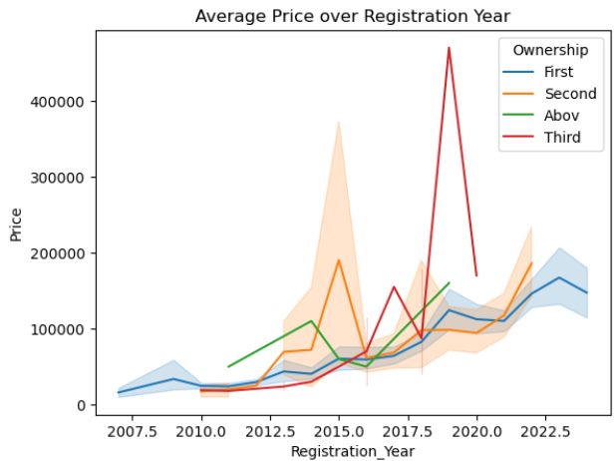
Data Analysis
Bi variate Analysis
Avg Price vs Registration Year: Newer bikes cost more.
Ownership Types: Price increase consistent.
Recent Bikes: Newer = Higher price; Older = Lower value.
2019 Change: High-end Benelli skewed data.

Slide 15
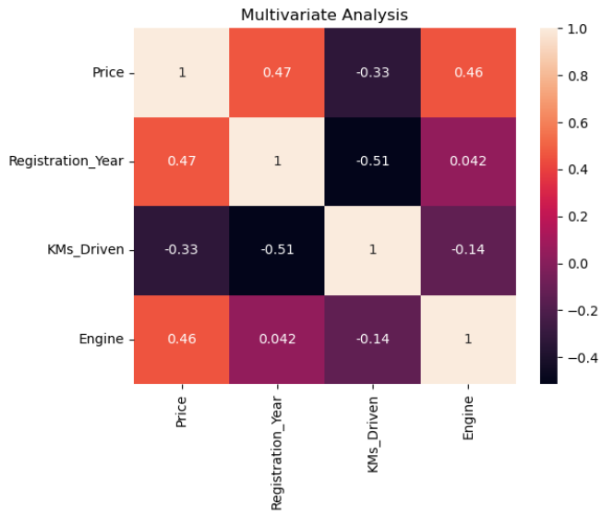
Data Analysis
Multivariate Analysis
Correlation table for Numerical features
Price-Registration : Directly proportional
Price- KMs_driven : Inversely Proportional
Registration year- KMs_driven: Inversely Proportional
 | Price | Registration_Year | KMs_Driven | Engine
Price | 1 | 0.466148 | -0.326594 | 0.457206
Registration_Year | 0.466148 | 1 | -0.512771 | 0.041908
KMs_Driven | -0.326594 | -0.512771 | 1 | -0.135618
Engine | 0.457206 | 0.041908 | -0.135618 | 1

Slide 16
Observations
Price-Registration : Directly proportional
Price- KMs_driven : Inversely Proportional
Registration year- KMs_driven: Inversely Proportional
Insights
“Royal Enfield” even though having more than average price still having higher count
Top : 5 Manufacturers:Bajaj ,Honda ,Royal Enfield , TVS ,Hero
Average Price of bikes : 97368.76
Corrections
Unicorn 160 bike with 0 kms need to be corrected
The highest priced bike is hero splendor plus priced at 8,50,000 which is incorrect and throws off average

Slide 17
Present state of
Site
First Page Bikes: Irrelevant bikes shown, not mostly available for sale.
No Price Range Filter: Price range feature not available
Unfeasible Prices: Some price ranges not practical (e.g., Splendor).
First Hand Bikes: Mostly first-hand bikes, few EVs.
EV Bikes Priority: EVs shown less priority but appear in top 5.

Slide 18

Final thoughts & Recommendations
For Buyers: Look for first-owner, low-mileage bikes from reputed brands for the best value.
For Sellers: Keeping the bike well-maintained and selling within 3-5 years maximizes resale value.
For BikeKharido.in: Implementing price recommendation tools and improving listing quality can enhance user experience.
Adding Price Range: Users mostly check for price range for their budget, adding this will improve user experience
Top Page listing: this should contain at least 30 percent of popular brands which will increase the sale and should have bikes with less KMs Driven

Slide 19
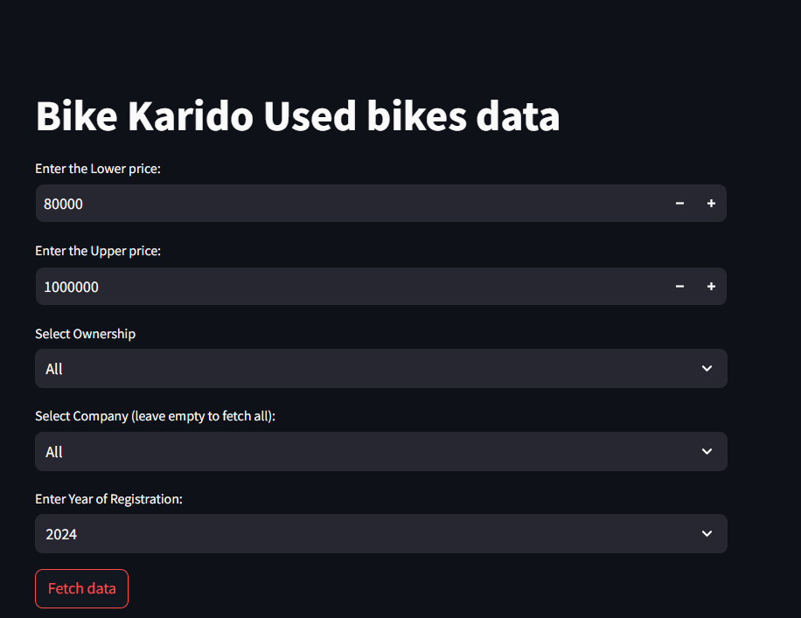
Streamlit Application
Streamlit
Streamlit application created for Second hand bikes data.
Having the following features:
Price range
Ownership
Company
Year of Registration

Slide 20
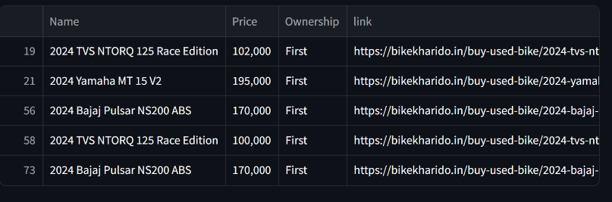
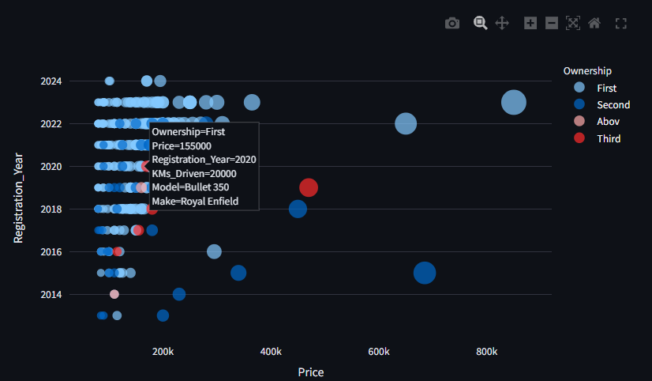
Streamlit Application
The application file placed in Github and then deployed in Streamlit community Cloud.
Once clicked fetch it will show the data with list, which can be downloaded as CSV
It shows a scatter plot where if we place on bubble it will show the bike details.

Slide 21
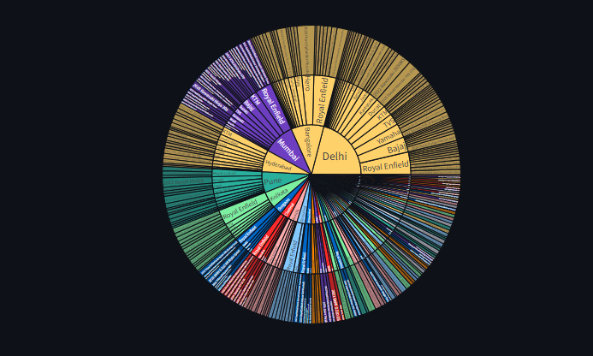
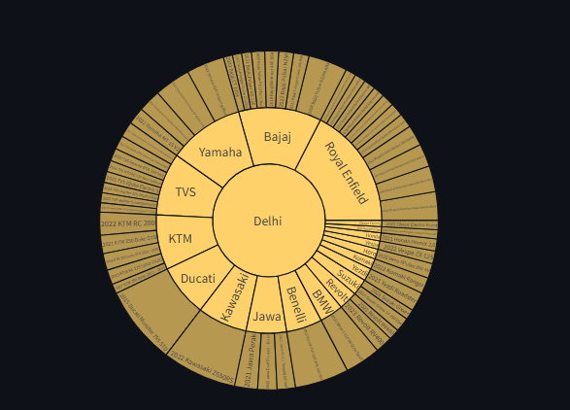
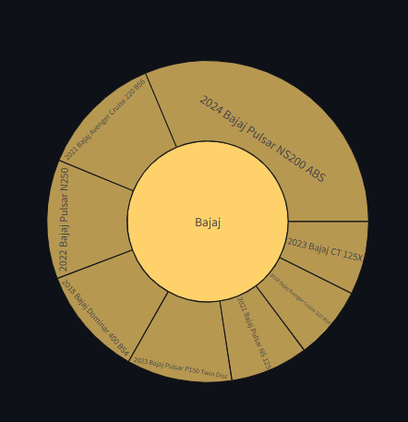
Streamlit Application
There is sunburst plot at the end where if we click on it will go through
location
Manufacturer
Bike
this will show all the details when we hover on it.

Slide 22

Thank You

